Slide 1


Capstone Project 2 Amin Yaesoubi Springboard Data Science Career Track February 2020
Capstone Project 2 Breast Cancer Classification

Slide 2
Overview
Breast cancer (BC) is one of the most common cancers among women worldwide.
The early diagnosis of BC can improve the prognosis and chance of survival significantly, as it can promote timely clinical treatment to patients.
Accurate classification of benign tumors can prevent patients undergoing unnecessary treatments.
The correct diagnosis of BC and classification of patients into malignant or benign groups is the subject of much research.
The goal is to classify whether the breast cancer is benign or malignant.
This analysis aims to observe which features are most helpful in predicting malignant or benign cancer.

Slide 3
Data : UCI Machine Learning Repository for BC
The dataset used in this story is publicly available and was created by Dr. William H. Wolberg, physician at the University of Wisconsin Hospital at Madison, Wisconsin, USA.
Dr. Wolberg used fluid samples, taken from patients with solid breast masses and an easy-to-use graphical computer program called Xcyt, which is capable of perform the analysis of cytological features based on a digital scan. The program uses a curve-fitting algorithm, to compute ten features from each one of the cells in the sample, then it calculates the mean value, extreme value and standard error of each feature for the image, returning a 30 real-valuated vector.

Slide 4
Data Wrangling
We conduct the following steps to clean up data and pick useful features.
1- Search for missing values:
Unnamed: 32 feature includes NaN, so we do not need it.
2- Drop duplicates:
Didn’t find any duplicates.
3- Diagnosis is our class label.
4- There is an id that can not be used for analysis and we drop it.
5- Because differences between values of features are very high to observe on plot (like the area_mean feature's max
value is 2500 and smoothness_mean features' max 0.16340.), so we need standardisation before visualization,
feature selection or classification.

Slide 5
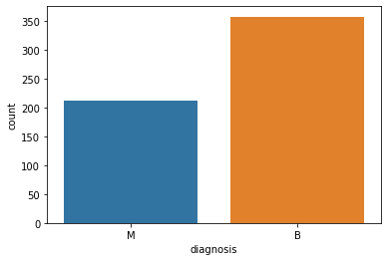
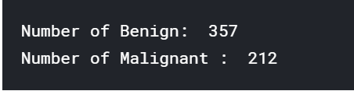
Data Exploration

Slide 6
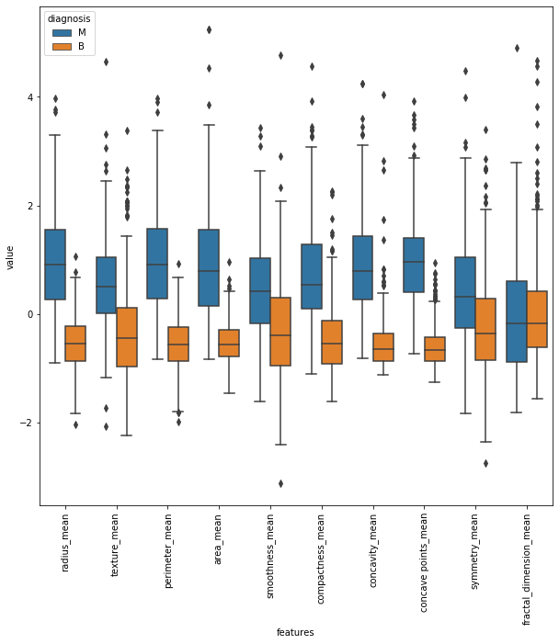
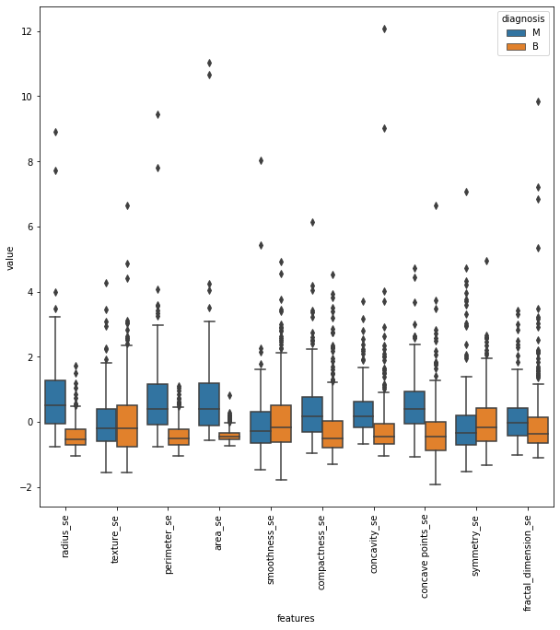
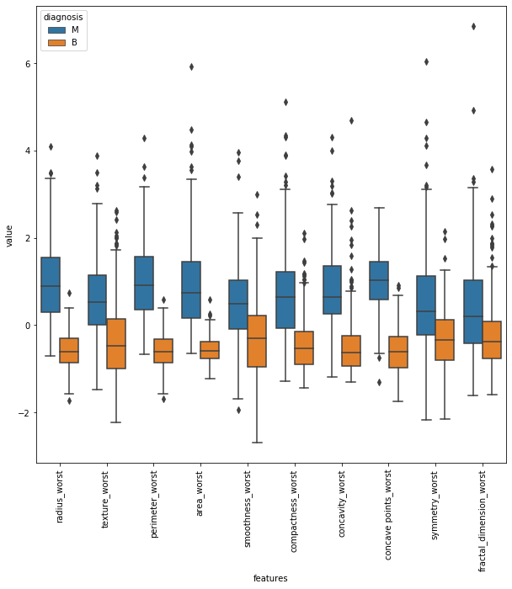
in texture_mean feature, median of the Malignant and Benign looks like separated so it can be good for classification.

Slide 7
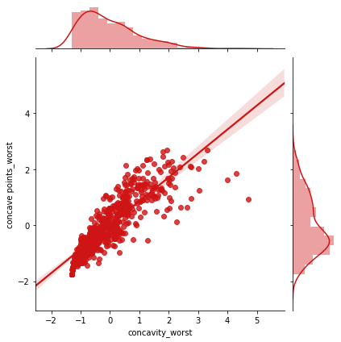
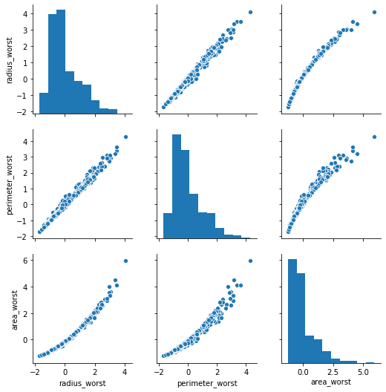

Slide 8
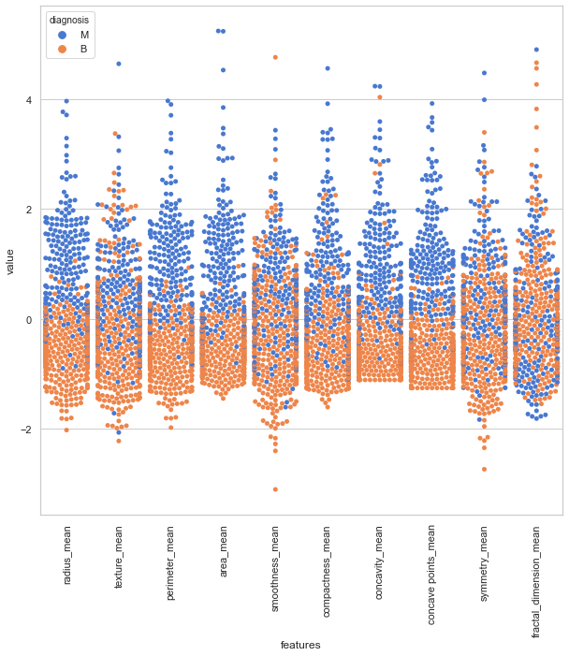
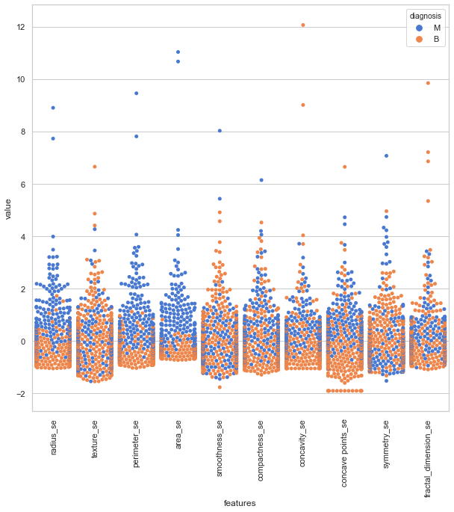
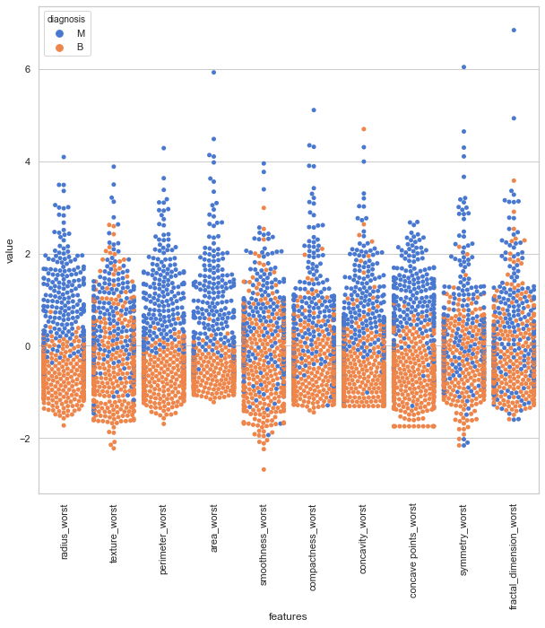

Slide 9
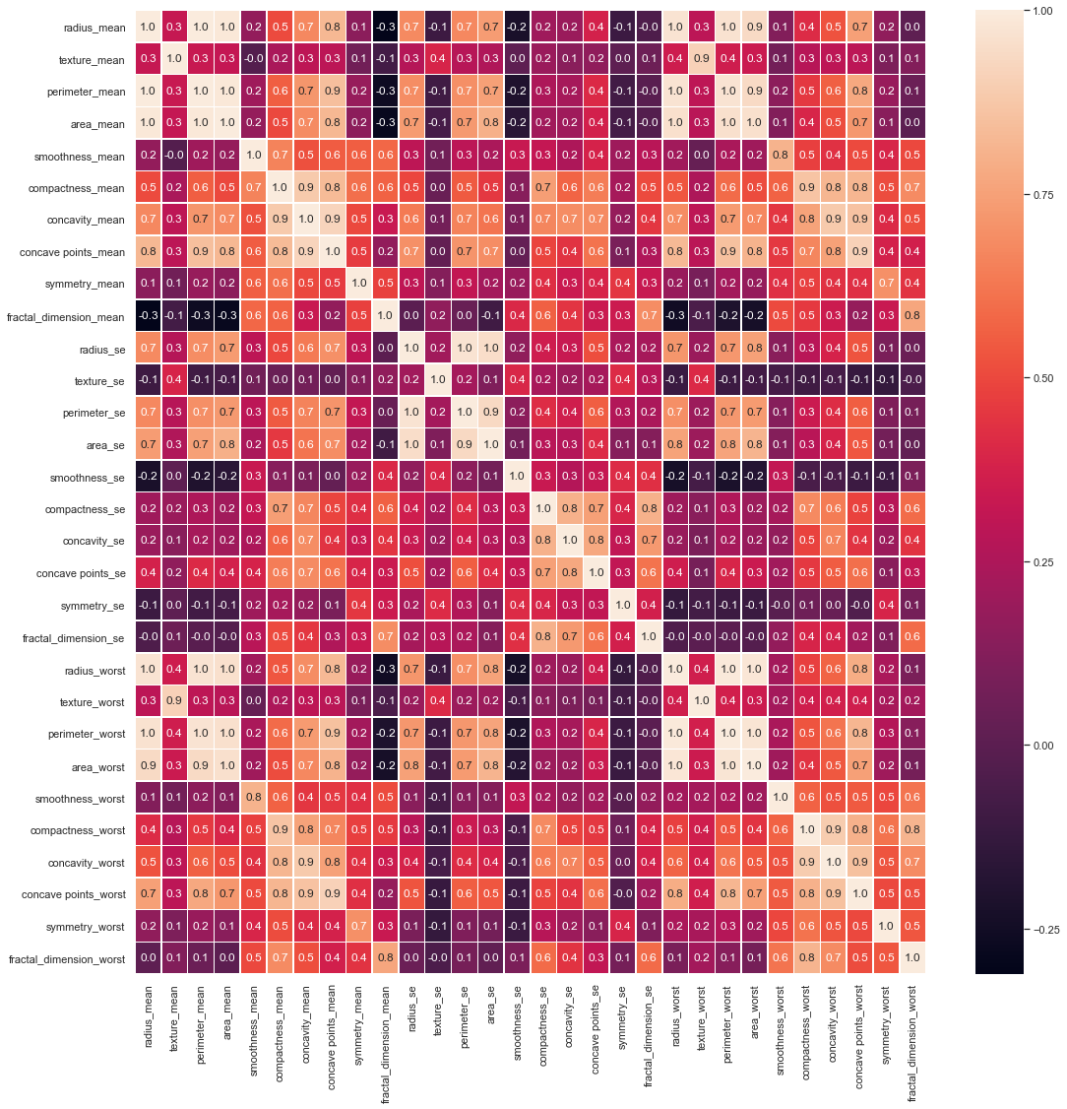

Slide 10
Machine Learning: Overview
Random Forest (RF) was used to find out importance of features.
Boruta and Variance Inflation Factor (VIF) used for features selection.
XGBoost was used for prediction.
Overall strategy:
Use Random Forest to find out importance of components
Reduce features with VIF compare with Boruta has more accuracy in this case
Use XGBoost on important components of all data.
Split the data into training and test datasets
Train various learning models, with cross-validated hyperparameter tuning
Apply the models to the test dataset to get measures of performance

Slide 11
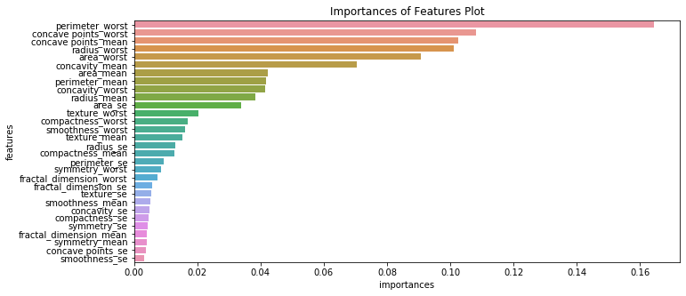
Random Forest

Slide 12
Machine Learning: XGBoost
Feature Selection with Bruta and VIF
With using Bruta, features has been reduced to 23 features and with using Variance Inflation Factor (VIF) features has been reduced to 13 features.
Feature Selection with Bruta and VIF
With using Bruta, features has been reduced to 23 features and with using Variance Inflation Factor (VIF) features has been reduced to 13 features.

Slide 13
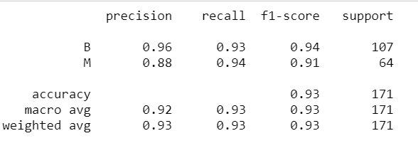

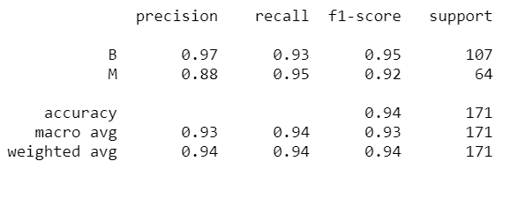

The results of the XGBoost algorithm with Boruta feature selection
The results of the XGBoost algorithm with Boruta feature selection

